Slide 1
Chapter 9-Monitoring and control
SOFTWARE
PROJECT MANAGEMENT

Slide 2
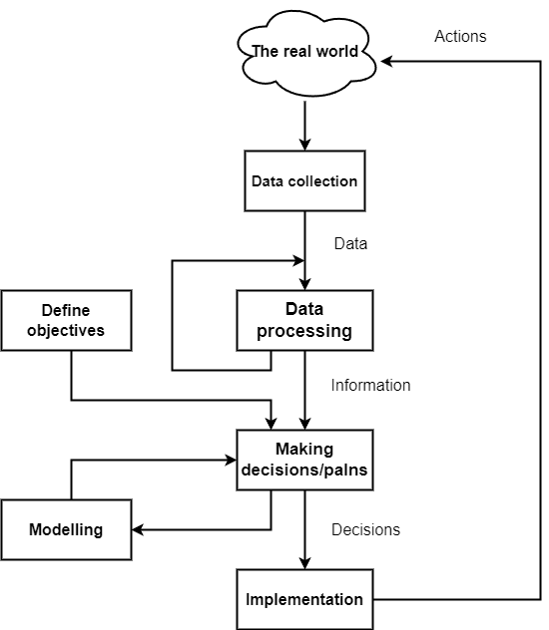
The control cycle
Notes:
Topics covered
Professional software development
What is meant by software engineering.
Software engineering ethics
A brief introduction to ethical issues that affect software engineering.
Suggested student projects
A brief introduction to each suggested project that can be carried out by students for this course

Slide 3
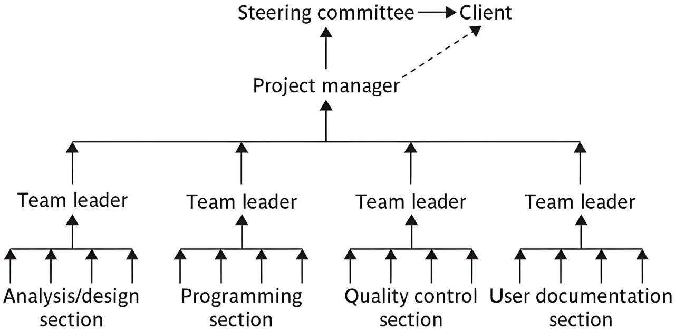
Responsibilities
Notes:
Topics covered
Professional software development
What is meant by software engineering.
Software engineering ethics
A brief introduction to ethical issues that affect software engineering.
Suggested student projects
A brief introduction to each suggested project that can be carried out by students for this course

Slide 4

Assessing progress
Checkpoints – predetermined times when progress is checked
Event driven: check takes place when a particular event has been achieved
Time driven: date of the check is pre-determined
Frequency of reporting
The higher the management level then generally the longer the gaps between checkpoints
Notes:
Topics covered
Professional software development
What is meant by software engineering.
Software engineering ethics
A brief introduction to ethical issues that affect software engineering.
Suggested student projects
A brief introduction to each suggested project that can be carried out by students for this course

Slide 5
Collecting progress details
Need to collect data about:
Achievements
Costs
A big problem: how to deal with partial completions 99% completion syndrome
Possible solutions:
Control of products, not activities
Subdivide into lots of sub-activities
5
Notes:
Topics covered
Professional software development
What is meant by software engineering.
Software engineering ethics
A brief introduction to ethical issues that affect software engineering.
Suggested student projects
A brief introduction to each suggested project that can be carried out by students for this course

Slide 6
Red/Amber/Green reporting
Identify key tasks
Break down into sub-tasks
Assess subtasks as:
  Green – ‘on target’
  Amber – ‘not on target but recoverable’
  Red – ‘not on target and recoverable only with difficulty’
Status of ‘critical’ tasks is particularly important
Notes:
Topics covered
Professional software development
What is meant by software engineering.
Software engineering ethics
A brief introduction to ethical issues that affect software engineering.
Suggested student projects
A brief introduction to each suggested project that can be carried out by students for this course

Slide 7
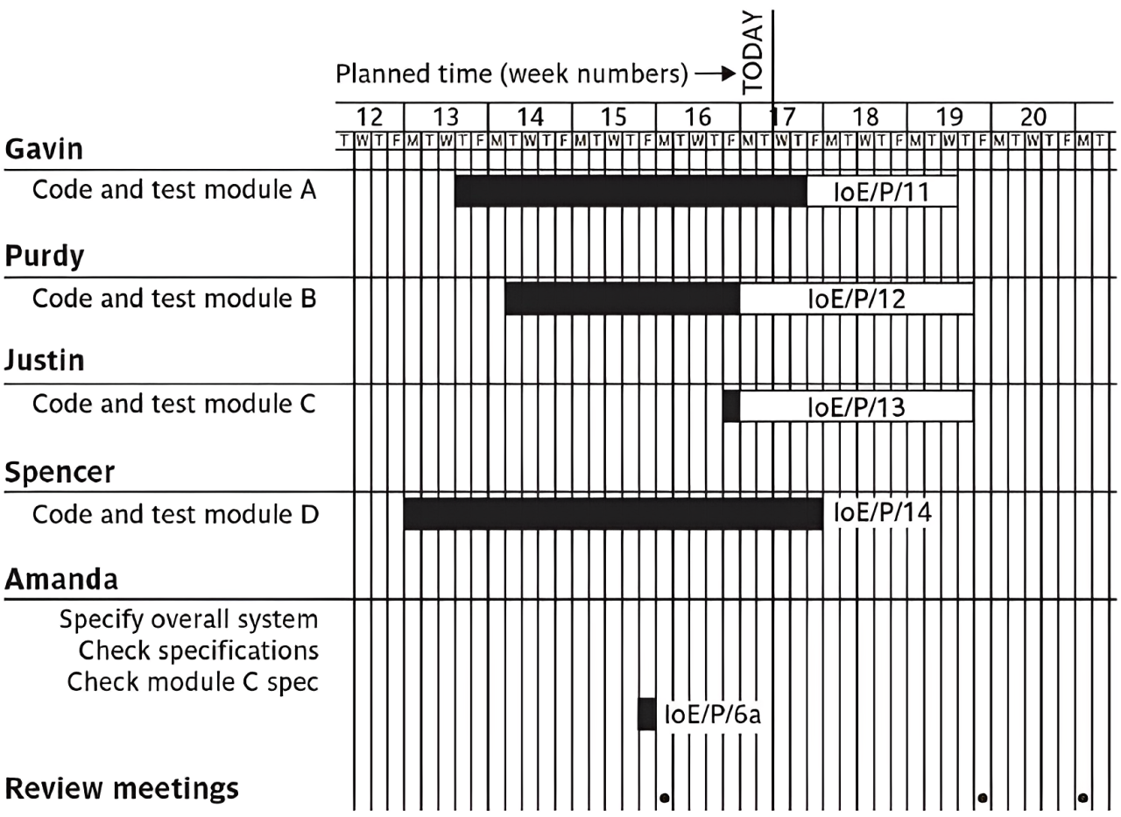
Gantt charts
Notes:
Topics covered
Professional software development
What is meant by software engineering.
Software engineering ethics
A brief introduction to ethical issues that affect software engineering.
Suggested student projects
A brief introduction to each suggested project that can be carried out by students for this course

Slide 8
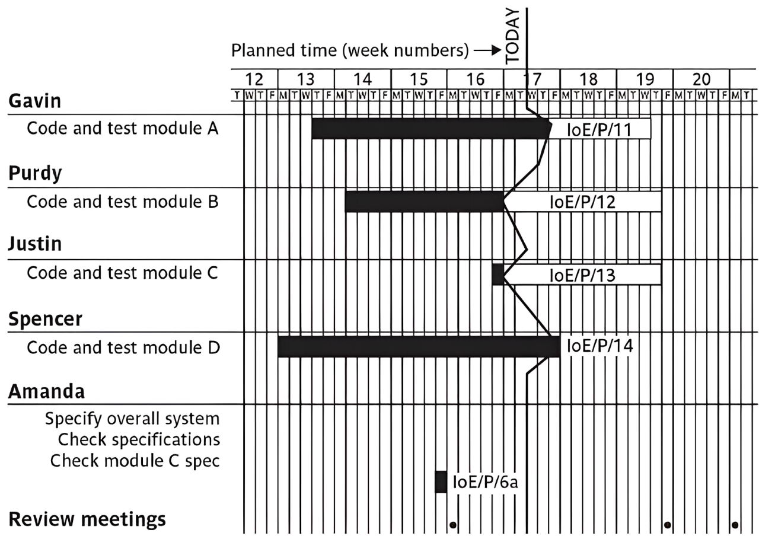
Slip charst
Notes:
Topics covered
Professional software development
What is meant by software engineering.
Software engineering ethics
A brief introduction to ethical issues that affect software engineering.
Suggested student projects
A brief introduction to each suggested project that can be carried out by students for this course

Slide 9
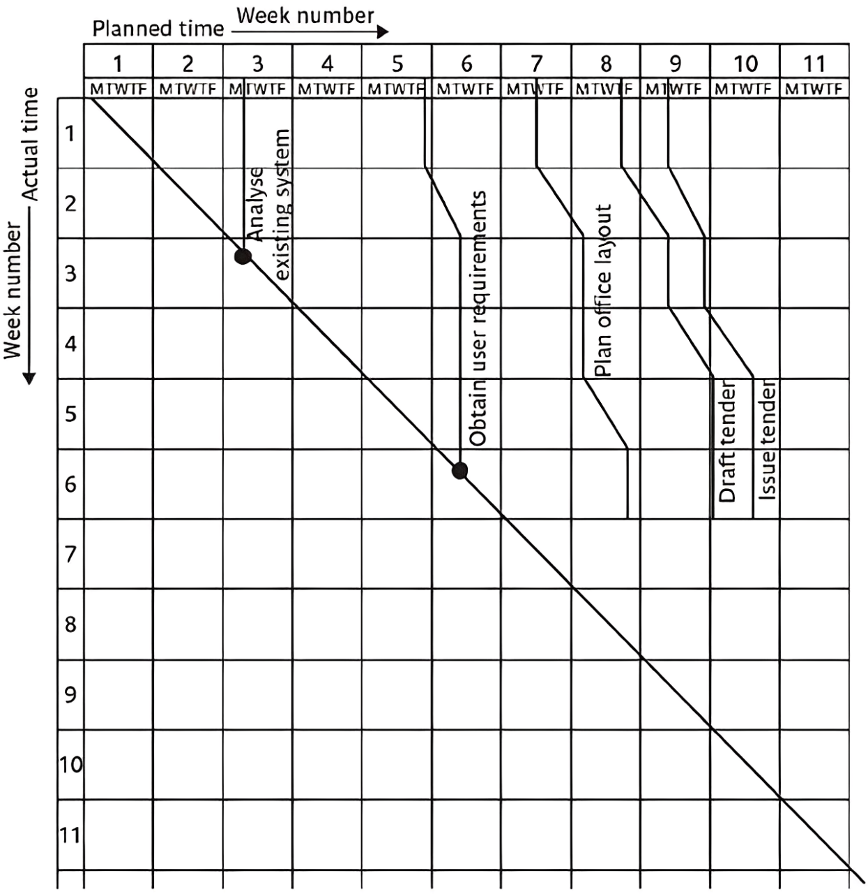
The timeline
Notes:
Topics covered
Professional software development
What is meant by software engineering.
Software engineering ethics
A brief introduction to ethical issues that affect software engineering.
Suggested student projects
A brief introduction to each suggested project that can be carried out by students for this course

Slide 10
Cost monitoring
A project could be late because the staff originally committed have not been deployed
In this case the project will be behind time but under budget
A project could be on time but only because additional resources have been added and so be over budget
Need to monitor both achievements and costs
Notes:
Topics covered
Professional software development
What is meant by software engineering.
Software engineering ethics
A brief introduction to ethical issues that affect software engineering.
Suggested student projects
A brief introduction to each suggested project that can be carried out by students for this course

Slide 11
Earned value analysis
Planned value (PV) or Budgeted cost of work scheduled (BCWS) – original estimate of the effort/cost to complete a task (compare with idea of a ‘price’)
Earned value (EV) or Budgeted cost of work performed (BCWP) – total of PVs for the work completed at this time
Notes:
Topics covered
Professional software development
What is meant by software engineering.
Software engineering ethics
A brief introduction to ethical issues that affect software engineering.
Suggested student projects
A brief introduction to each suggested project that can be carried out by students for this course

Slide 12
Accounting conventions
Work completed allocated on the basis
  50/50 half allocated at start, the other half on completion. These proportions can vary e.g. 0/100, 75/25 etc
  Milestone current value depends on the milestones achieved
  Units processed
Can use money values, or staff effort as a surrogate
Notes:
Topics covered
Professional software development
What is meant by software engineering.
Software engineering ethics
A brief introduction to ethical issues that affect software engineering.
Suggested student projects
A brief introduction to each suggested project that can be carried out by students for this course

Slide 13
Earned value – an example
Tasks
  Specify module 5 days
  Code module 8 days
  Test module 6 days
At the beginning of day 20, PV = 19 days
If everything but testing completed EV = 13 days
Schedule variance = EV-PV i.e = -6
Schedule performance indicator (SPI) = 13/19 = 0.68
SV negative or SPI <1.00, project behind schedule
Notes:
Topics covered
Professional software development
What is meant by software engineering.
Software engineering ethics
A brief introduction to ethical issues that affect software engineering.
Suggested student projects
A brief introduction to each suggested project that can be carried out by students for this course

Slide 14
Earned value analysis – actual cost
Actual cost (AC) is also known as Actual cost of work performed (ACWP)
In previous example, if
  ‘Specify module’ actually took 3 days
  ‘Code module’ actually took 4 days
Actual cost = 7 days
Cost variance (CV) = EV-AC i.e = 6 days
Cost performance indicator = 13/7 = 1.86
Positive CV or CPI > 1.00 means project within budget
Notes:
Topics covered
Professional software development
What is meant by software engineering.
Software engineering ethics
A brief introduction to ethical issues that affect software engineering.
Suggested student projects
A brief introduction to each suggested project that can be carried out by students for this course

Slide 15
Earned value analysis – actual costs
CPI can be used to produce new cost estimate
Budget at completion (BAC) – current budget allocated to total costs of project
Estimate at completion (EAC) – updated estimate = BAC/CPI
  e.g. say budget at completion is £19,000 and CPI is 1.86
  EAC = BAC/CPI = £10,215 (projected costs reduced because work being completed in less time)
Notes:
Topics covered
Professional software development
What is meant by software engineering.
Software engineering ethics
A brief introduction to ethical issues that affect software engineering.
Suggested student projects
A brief introduction to each suggested project that can be carried out by students for this course

Slide 16
Time variance
Time variance (TV) – difference between time when specified EV should have been reached and time it actually was
For example say an EV of £19000 was supposed to have been reached on 1st April and it was actually reached on 1st July then TV = - 3 months
Notes:
Topics covered
Professional software development
What is meant by software engineering.
Software engineering ethics
A brief introduction to ethical issues that affect software engineering.
Suggested student projects
A brief introduction to each suggested project that can be carried out by students for this course

Slide 17
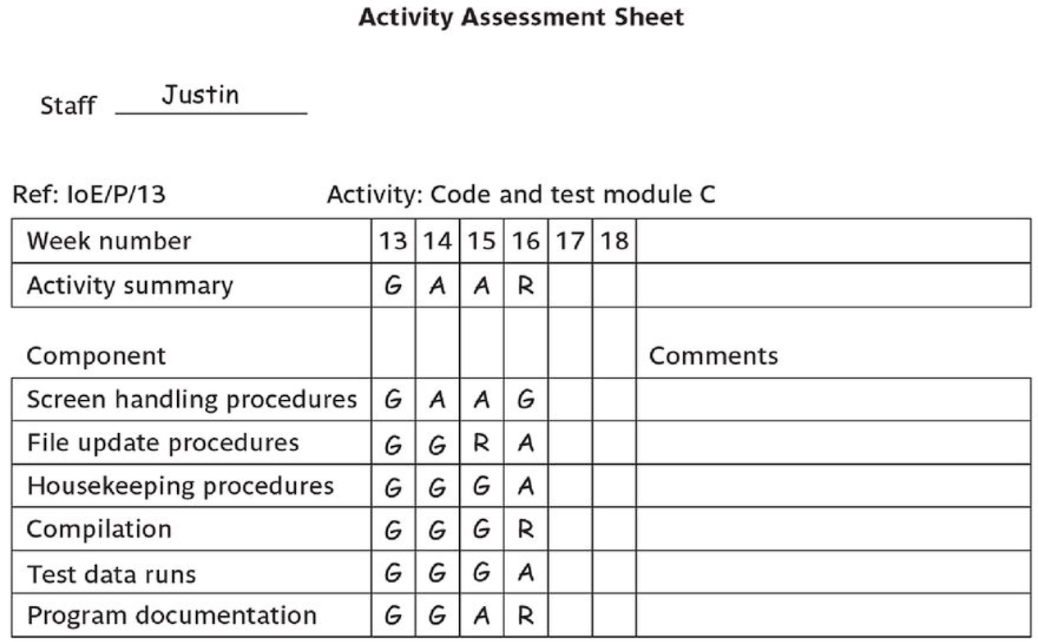
Earned value chart with revised forecasts
Notes:
Topics covered
Professional software development
What is meant by software engineering.
Software engineering ethics
A brief introduction to ethical issues that affect software engineering.
Suggested student projects
A brief introduction to each suggested project that can be carried out by students for this course

Slide 18
Prioritizing monitoring
We might focus more on monitoring certain types of activity e.g.
Critical path activities
Activities with no free float – if delayed later dependent activities are delayed
Activities with less than a specified float
High risk activities
Activities using critical resources
Notes:
Topics covered
Professional software development
What is meant by software engineering.
Software engineering ethics
A brief introduction to ethical issues that affect software engineering.
Suggested student projects
A brief introduction to each suggested project that can be carried out by students for this course

Slide 19
Getting back on track: options
Renegotiate the deadline – if not possible then
Try to shorten critical path e.g.
  Work overtime
  Re-allocate staff from less pressing work
  Buy in more staff
Reconsider activity dependencies
  Over-lap the activities so that the start of one activity does not have to wait for completion of another
  Split activities
Notes:
Topics covered
Professional software development
What is meant by software engineering.
Software engineering ethics
A brief introduction to ethical issues that affect software engineering.
Suggested student projects
A brief introduction to each suggested project that can be carried out by students for this course

Slide 20
Exception planning
Some changes could affect
  Users
  The business case (e.g. costs increase reducing the potential profits of delivered software product)
These changes could be to
  Delivery date
  Scope
  Cost
In these cases an exception report is needed
Notes:
Topics covered
Professional software development
What is meant by software engineering.
Software engineering ethics
A brief introduction to ethical issues that affect software engineering.
Suggested student projects
A brief introduction to each suggested project that can be carried out by students for this course

Slide 21
Exception planning - continued
First stage
  Write an exception report for sponsors (perhaps through project board)
    Explaining problems
    Setting out options for resolution
Second stage
  Sponsor selects an option ( or identifies another option)
  Project manager produces an exception plan implementing selected option
  Exception plan is reviewed and accepted/rejected by sponsors/Project Board
Notes:
Topics covered
Professional software development
What is meant by software engineering.
Software engineering ethics
A brief introduction to ethical issues that affect software engineering.
Suggested student projects
A brief introduction to each suggested project that can be carried out by students for this course

Slide 22
Change control
The role of configuration librarian:
Identifying items that need to be subject to change control
Management of a central repository of the master copies of software and documentation
Administering change procedures
Maintenance of access records
Notes:
Topics covered
Professional software development
What is meant by software engineering.
Software engineering ethics
A brief introduction to ethical issues that affect software engineering.
Suggested student projects
A brief introduction to each suggested project that can be carried out by students for this course

Slide 23
Typical change control process
One or more users might perceive the need for a change
User management decide that the change is valid and worthwhile and pass it to development management
A developer is assigned to assess the practicality and cost of making the change
Development management report back to user management on the cost of the change; user management decide whether to go ahead
Notes:
Topics covered
Professional software development
What is meant by software engineering.
Software engineering ethics
A brief introduction to ethical issues that affect software engineering.
Suggested student projects
A brief introduction to each suggested project that can be carried out by students for this course

Slide 24
Change control process contd.
One or more developers are authorized to make copies of components to be modified
Copies modified. After initial testing, a test version might be released to users for acceptance testing
When users are satisfied then operational release authorized – master configuration items updated
Notes:
Topics covered
Professional software development
What is meant by software engineering.
Software engineering ethics
A brief introduction to ethical issues that affect software engineering.
Suggested student projects
A brief introduction to each suggested project that can be carried out by students for this course

